Slide 1
An Introduction to Python and Its Use in Bioinformatics

Slide 2
What is Python?
A portable, interpretive, object-oriented programming language
Elegant syntax
Powerful high-level built-in data types
Numbers, strings, lists, dictionaries
Full set of string operations

Slide 3
Useful Tutorials
DNA from the Beginning
http://www.dnaftb.org/dnaftb/
Python Tutorial
http://www.python.org/doc/current/tut/tut.html

Slide 4
Python Development Open-Source Software
Python interpreter - will run on windows, you need to download it in two parts:
1. The actual interpreter and core of python http://www.python.org/2.3.3/ (get the Python-2.3.3.exe file. There is a newer release (2.4.1) that you can download if you’d prefer.)
2. An integrated development environment for python called pythonwin, by Mark Hammond http://starship.python.net/crew/mhammond/win32/Downloads.html

Slide 5
Python Basics - Comments
Python comments
# line comment
Header comments
#Description of program
#Written by:
#Date created:
#Last Modified:

Slide 6
Python Basics - Variables
Python variables are not “declared”.
To assign a variable, just type: identifier=literal
Identifiers
Have the following restrictions:
Must start with a letter or underscore (_)
Case sensitive
Must consist of only letters, numbers or underscore
Must not be a reserved word
Have the following conventions:
All uppercase letters are used for constants
Variable names are meaningful – thus, often multi-word (but not too long)
Convention 1: alignment_sequence (align_seq)
Convention 2: AlignmentSequence (AlignSeq)
Python specific conventions (Avoid _X, __X__, __X, _)

Slide 7
Numbers
Numbers
Normal Integers –represent whole numbers
Ex: 3, -7, 123, 76
Long Integers – unlimited size
Ex: 9999999999999999999999L
Floating-point – represent numbers with decimal places
Ex: 1.2, 3.14159,3.14e-10
Octal and hexadecimal numbers
Ex: O177, 0x9ff, Oxff
Complex numbers
Ex: 3+4j, 3.0+4.0j, 3J

Slide 8
Python Basics – arithmetic operations
Operators Example
+ add
- subract
* multiply
/ divide
% modulus/remainder
y=5; z=3
x = y + z
x = y – z
x = y * z
x = y / z
x = y % z
x = 8
x = 2
x = 15
x = 1
x = 2

Slide 9
Python Basics – Relational and Logical Operators
Relational operators
== equal
!=, <> not equal
> greater than
>= greater than or
equal
< less than
<= less than or equal
Logical operators
and and
or or
not not

Slide 10
Strings
Enclosed in single or double quotes
Ex: ‘Hello!’ , “Hello!”, “3.5”, “a”, ‘a’
Sequence of characters: mystring=“hello world!”
mystring[0] -> “h” mystring[1] -> “e”
mystring[2] -> “l” mystring[-1] -> “!”
-1 is last,
-2 next to last, etc…

Slide 11
String operations
mystring = “Hello World!”
Expression | Value | Purpose
len(mystring) | 12 | number of characters in mystring
“hello”+“world” | “helloworld” | Concatenate strings
“%s world”%“hello” | “hello world” | Format strings (like sprintf)
“world” == “hello” “world” == “world” | 0 or False 1 or True | Test for equality
“a” < “b” “b” < “a” | 1 or True 0 or False | Alphabetical ordering

Slide 12
Strings (2)
slicing: mystring = “spoon!”
mystring[2:] -> “oon!” mystring[:3] -> “spo” #note last element is never included! mystring[1:3]-> “po”
Many useful built-in functions
mystring.upper() -> “SPOON!”
mystring.replace(‘o’, ‘O’) -> “spOOn!”

Slide 13
Strings (3)
“%” operator: sort of “fill in the blanks” operation: mystring=“%s has %d marbles” % (“John”,35) mystring -> “John has 35 marbles”
%s replace with string
%d,%i replace with integer
%f replace with float
“blanks”
Values to put in blanks

Slide 14
Lists
mylist=[“a”,”b”,3.58,”d”,4,0]
mylist[0] mylist[2] | a 3.58 | Indexing
mylist[-1] mylist[-2] | 0 4 | Negative indexing (counts from end)
mylist[1:4] | [“b”,3.58,”d”] | Slicing (like strings)
“b” in mylist “e” not in mylist | 1 or True 1 or True
mylist.append(8) | [“a”,”b”,3.58,”d”,4,0,8] | Add to end of list

Slide 15
Tuples
Tuples – sequence of values like lists, but cannot be changed after it is created mytuple=(1,”a”,”bc”,3,87.2) mytuple[2] -> “bc”
mytuple[1]=“3”
Used when you want to pass several variables around at once
Error!

Slide 16
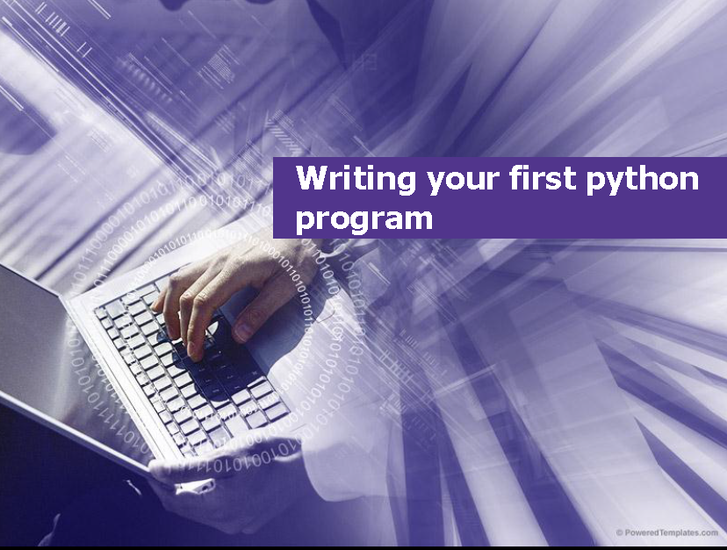

Slide 17
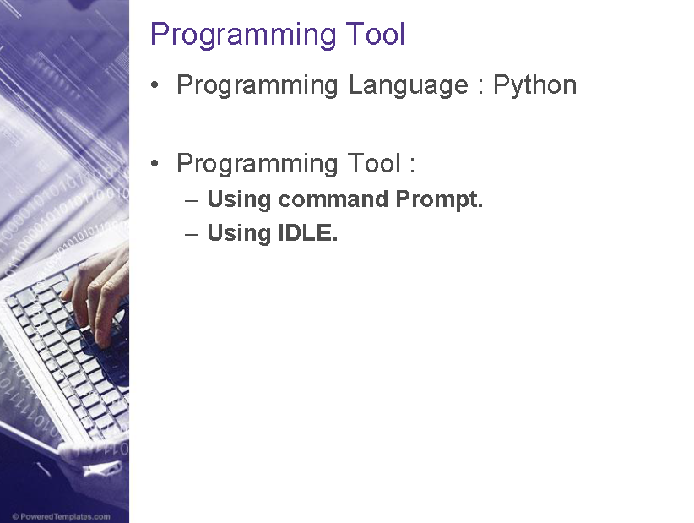

Slide 18
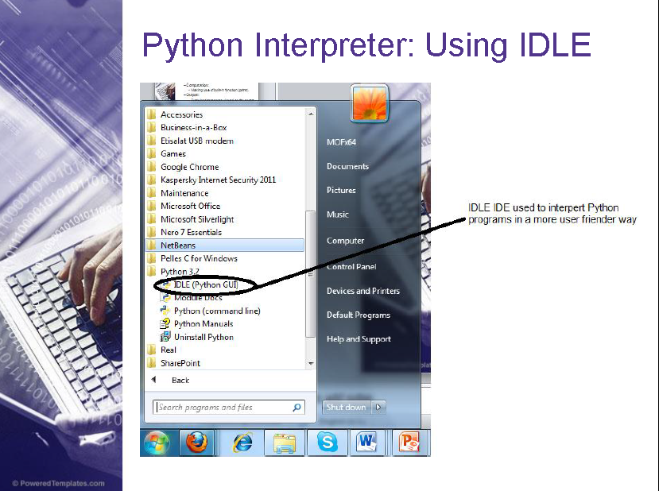

Slide 19
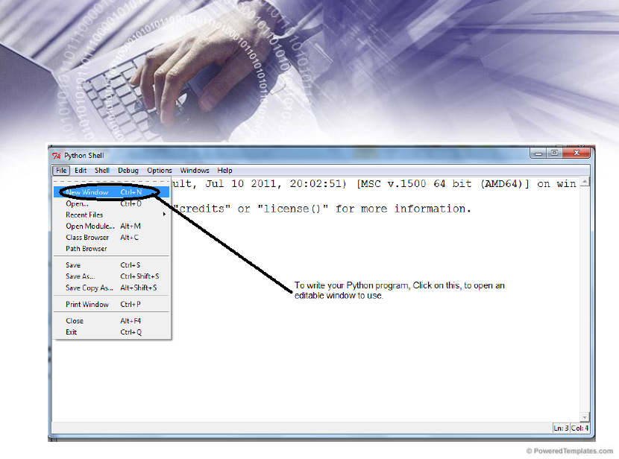

Slide 20
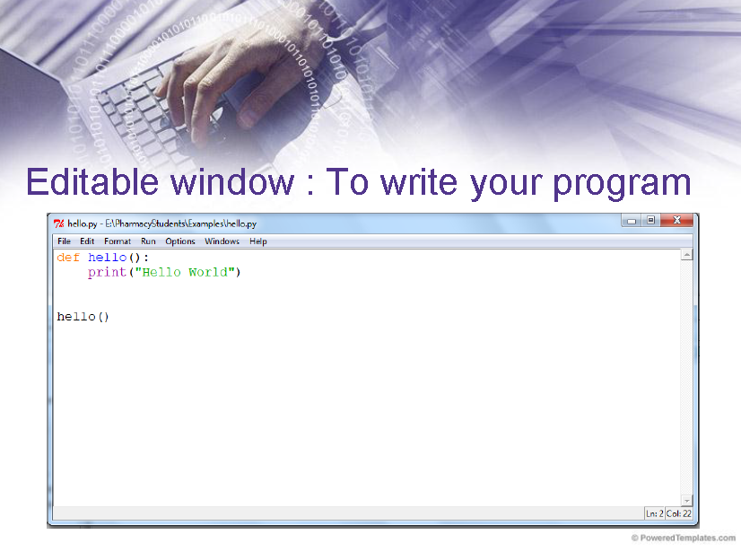

Slide 21
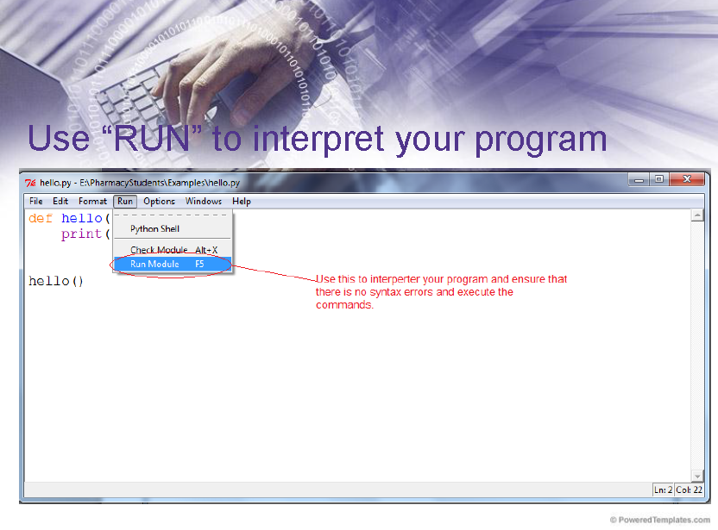

Slide 22
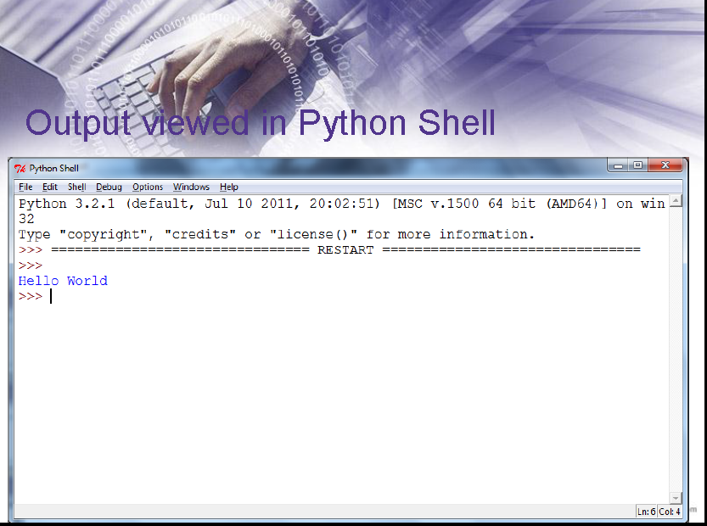

Slide 23
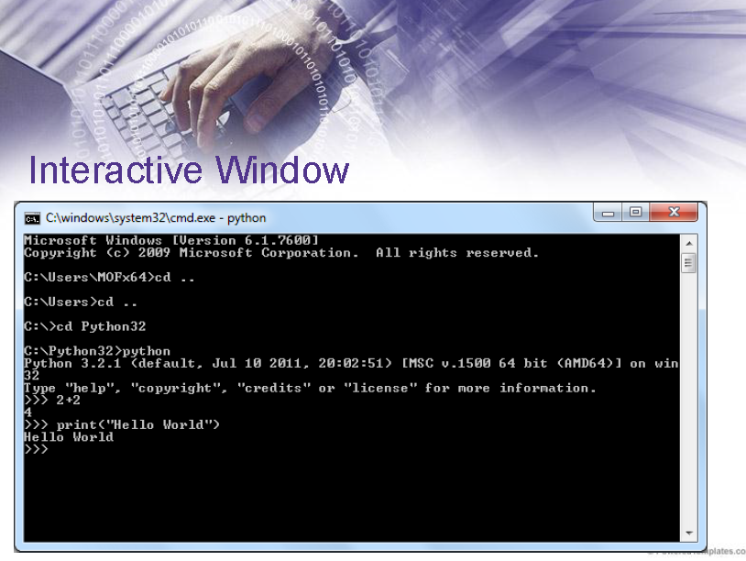

Slide 24
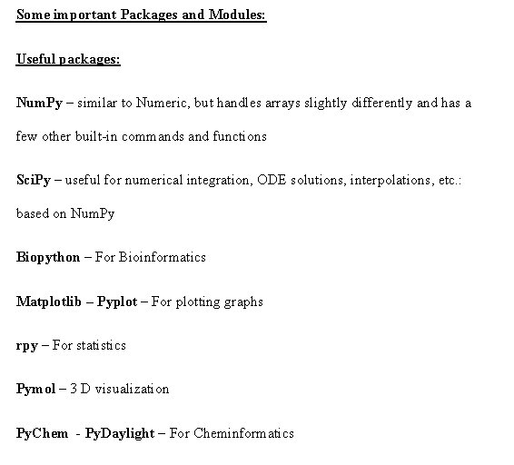
Why Python for Us?

Slide 25
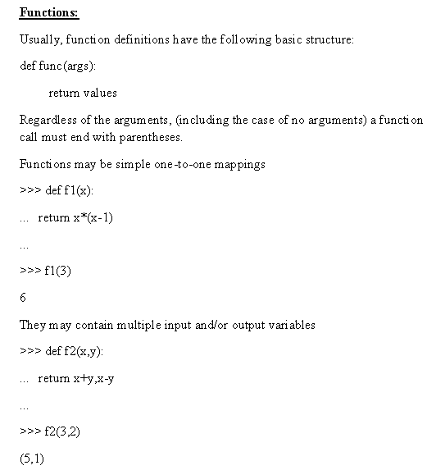

Slide 26
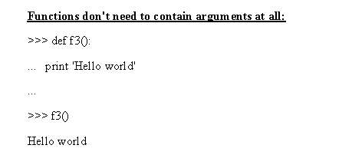

Slide 27
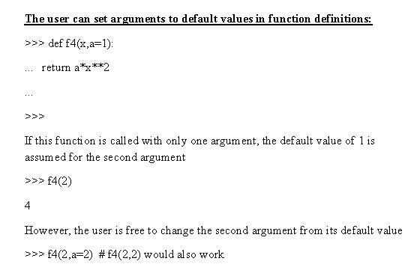

Slide 28
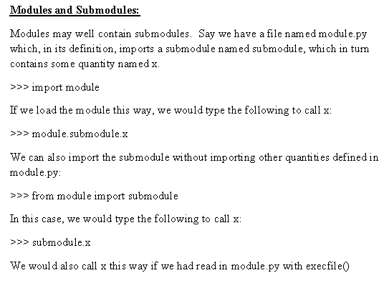

Slide 29
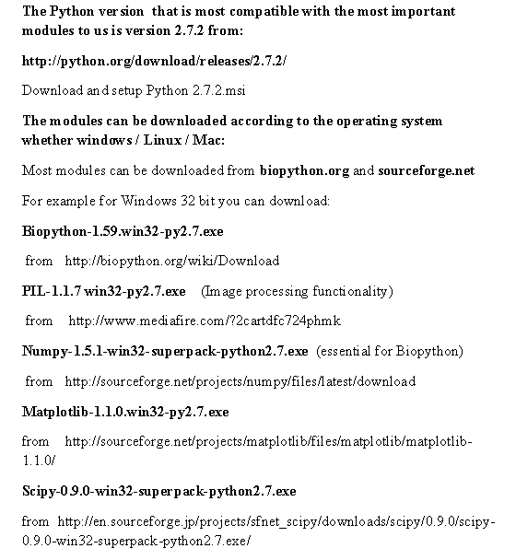

Slide 30
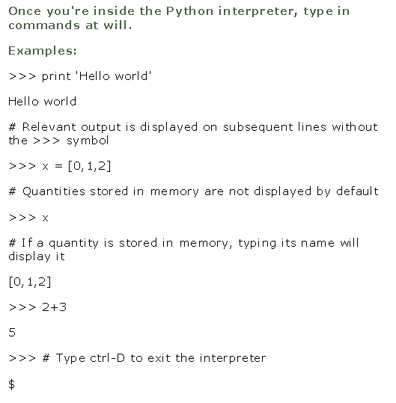

Slide 31
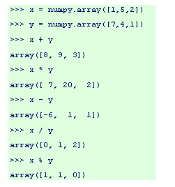
Module Example: Numpy

Slide 32
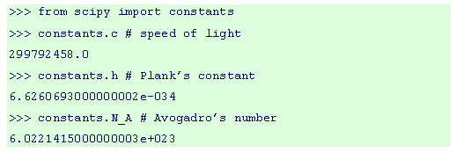
Scipy

Slide 33
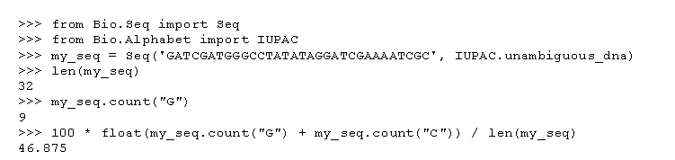
Biopython

Slide 34



Matplotlib

